Slide 1
Mean State High Cloud Relationships to Climate Sensitivity
Emma Dawson and Kathleen Schiro
University of Virginia
12/11/2023

Slide 2
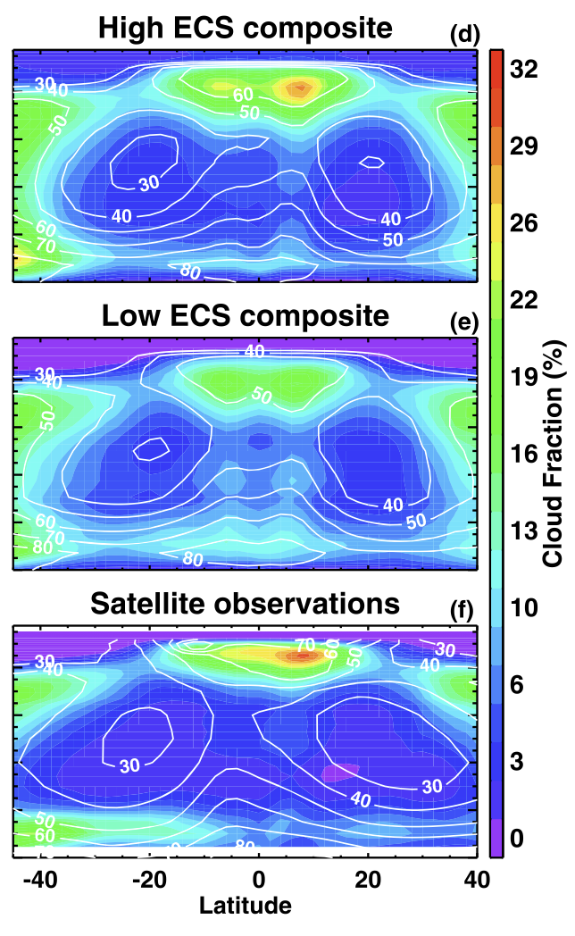
Motivation
CMIP6
CMIP5
High ECS models have greater tropical high cloud fraction than low ECS models
Similarities between observations and high ECS tropical upper tropospheric cloud fraction
Su et al., 2014
Notes:
This project was first motivated by findings that show that high ECS models tend to exhibit greater tropical upper tropospheric cloud fraction than low ECS models
This has been seen across both the CMIP5 and CMIP6 ensembles as shown in comparing the top to the middle panels in the figures shown here
Additionally, satellite observations more closely reflect the higher coverage seen in the high ECS models
We wanted to analyze differences mean state tropical high cloud coverage across better understand why there may be a linkage between climatological coverage and climate sensitivity

Slide 3
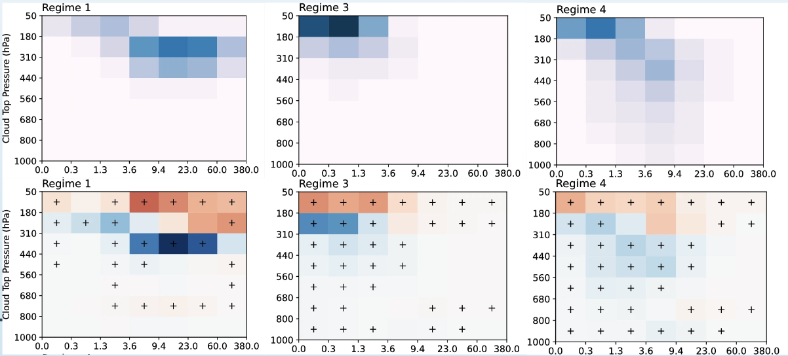
Motivation
Evidence of relationship between high cloud fraction changes under warming and climate sensitivity; mean high cloud fraction and changes with warming
Possibility for emergent constraint
Schiro et al., 2022
Zelinka et al., 2023
Notes:
In addition to relationships between mean cloud coverage and climate sensitivity, there is also evidence that the change in high clouds under warming varies between high and low ECS models
For example, this top figure from Schiro et al. (2022) suggests a greater loss of high clouds in the tropical deep convective regions in models with higher climate sensitivity than in models with lower climate sensitivity
This suggests that there may be a relationship between the mean state and changes with warming; for example, this figure from Zelinka et al., 2022 demonstrates that there is an increase in high cloud fraction is associated with cloud-regimes dominated by higher cloud amount in the mean state

Slide 4
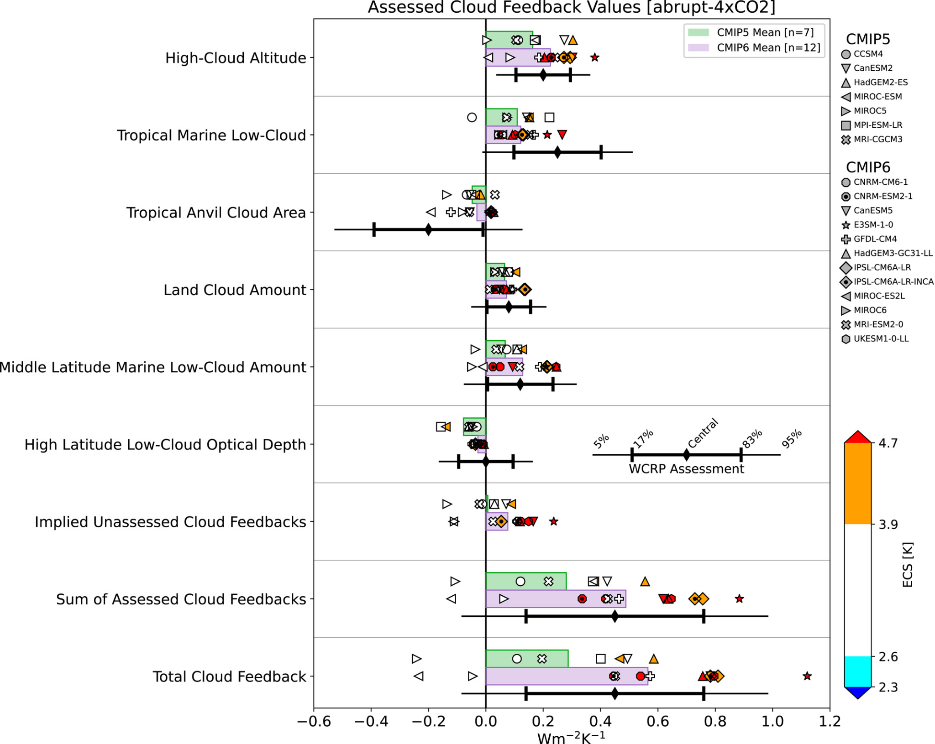
Motivation
*
Uncertainty in magnitude of high cloud feedbacks in GCMs
*
Zelinka et al., 2022

Slide 5
II. Research Questions
To what extent does the intermodel spread in high cloud feedbacks contribute to the intermodel spread in ECS?
What role does the mean state play? Does mean-state high cloud fraction relate to high cloud feedbacks?

Slide 6
III. Methods
18 models using monthly mean output of piControl/piClim-control & abrupt4xCO2 runs
Zelinka et al., 2012; 2016 cloud feedback decomposition; exclusion of 0 < 𝛕 < 1.3
Thin HCF
Thick HCF
Zelinka et al., 2012

Slide 7
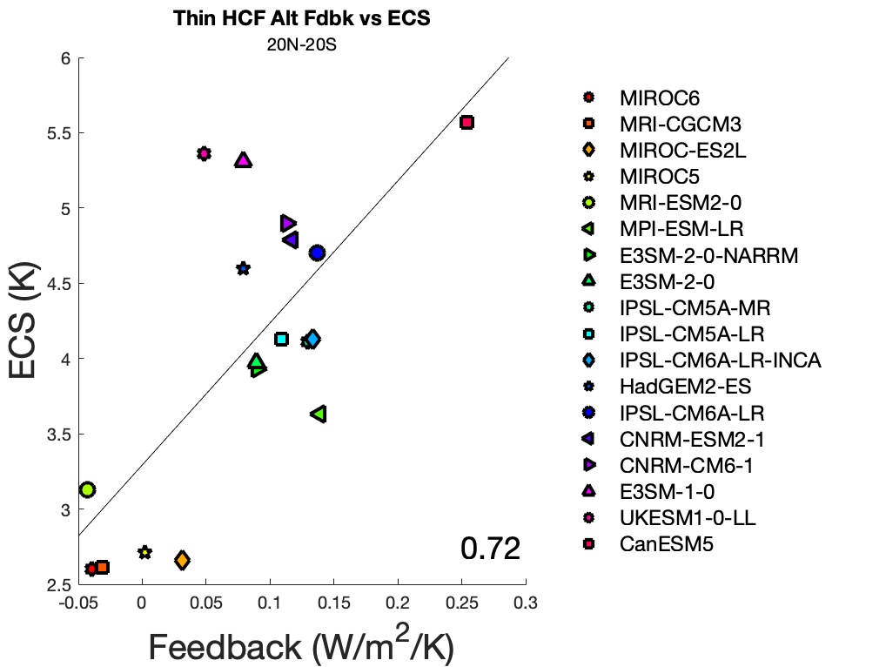
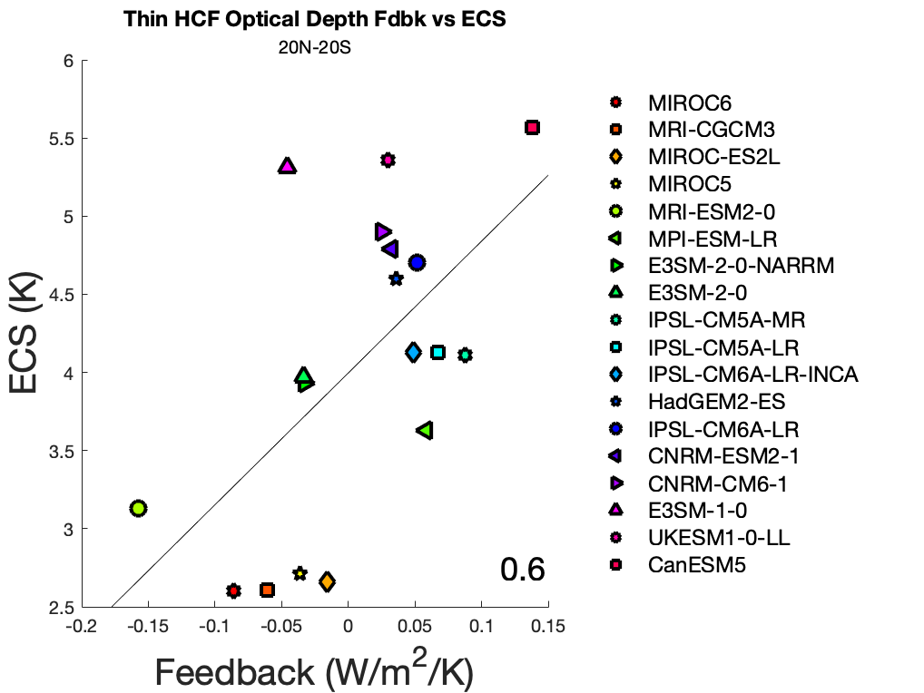
IV. Results
Altitude
Optical Depth
Strong, positive correlations between thin, high cloud feedbacks and climate sensitivity

Slide 8
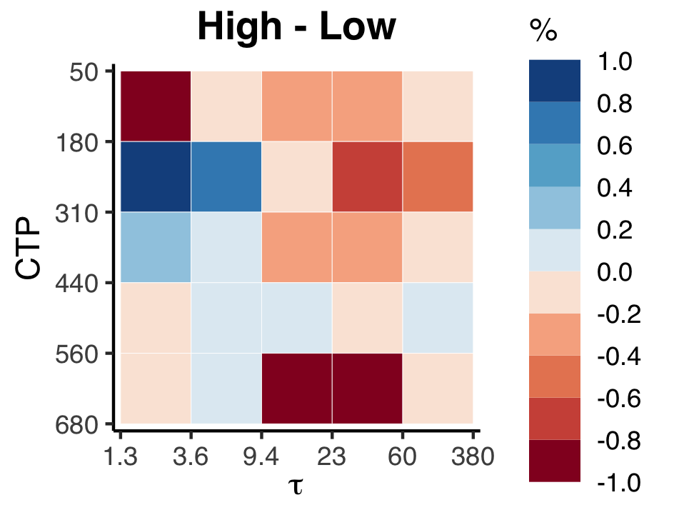
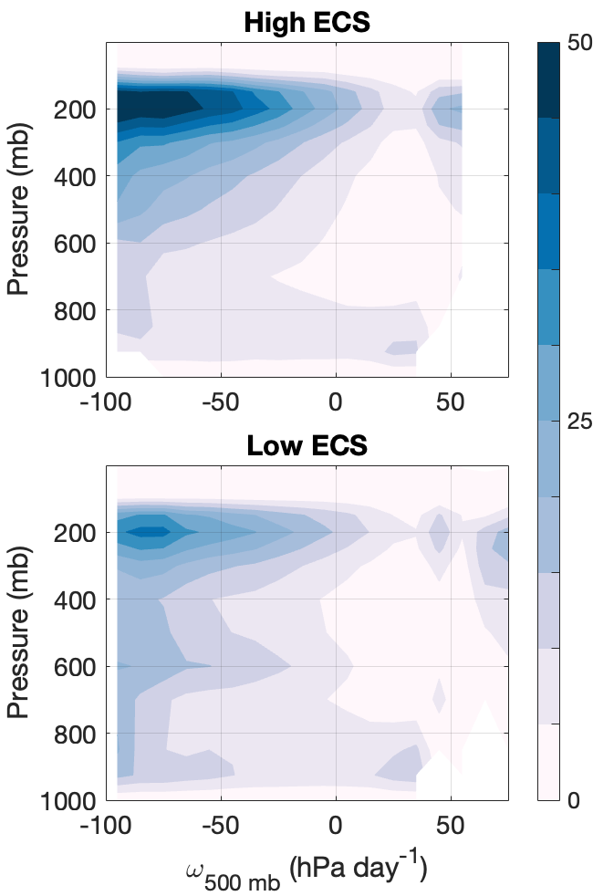
IV. Results - Mean State
High ECS models have more high clouds in the mean state (left), but the clouds are thinner (top).

Slide 9
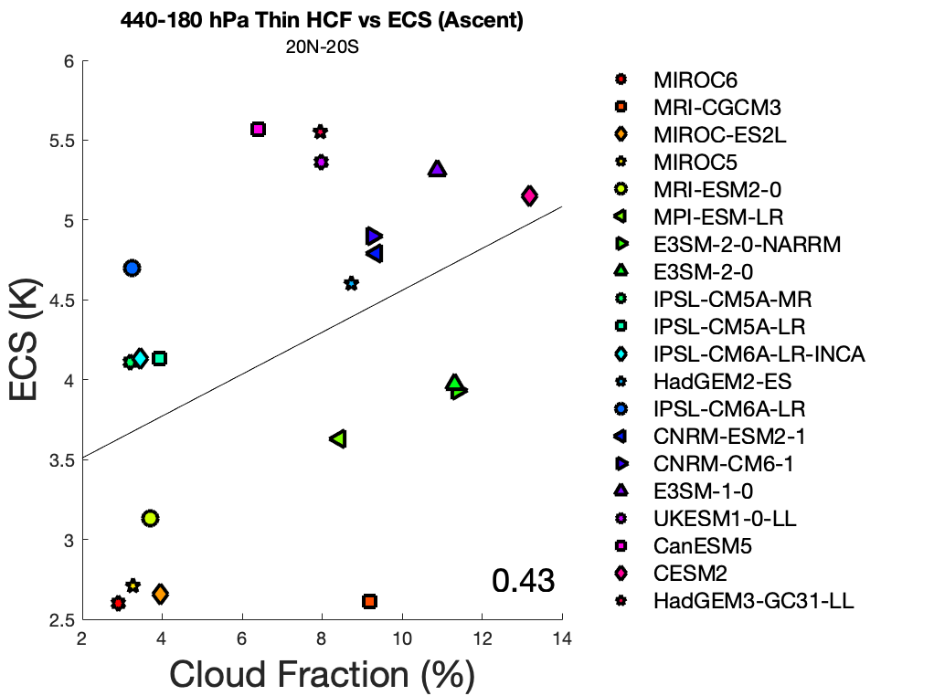
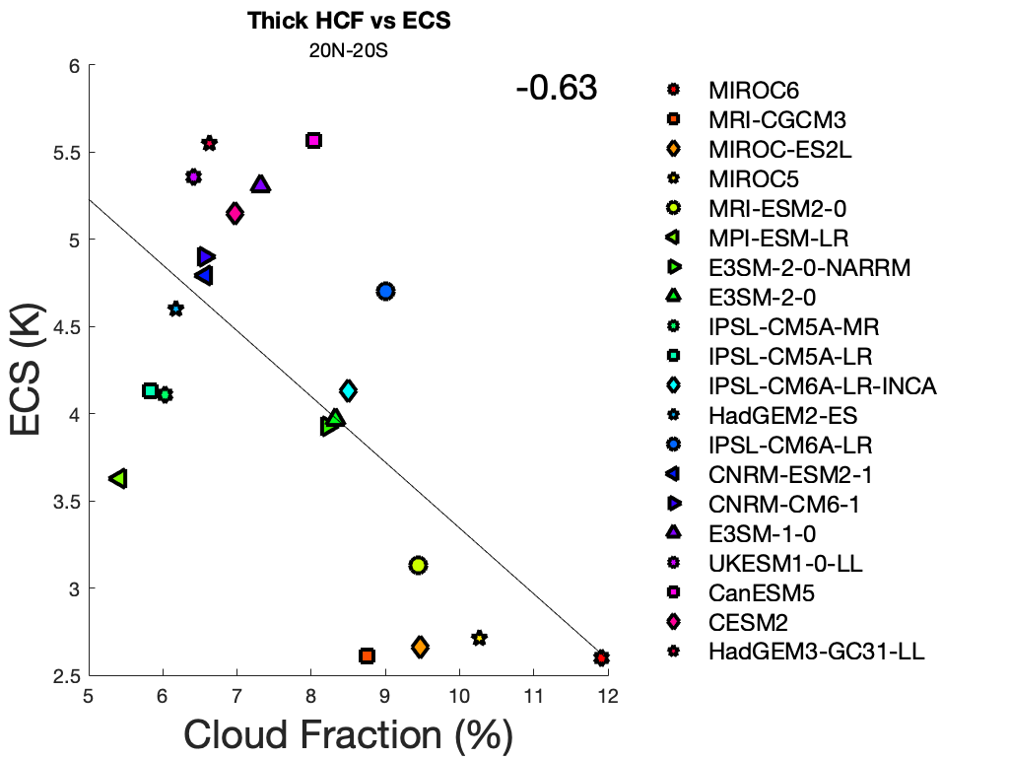
IV. Results - Mean State
High ECS models have:
Fewer thick high clouds
More high clouds in the mean state

Slide 10
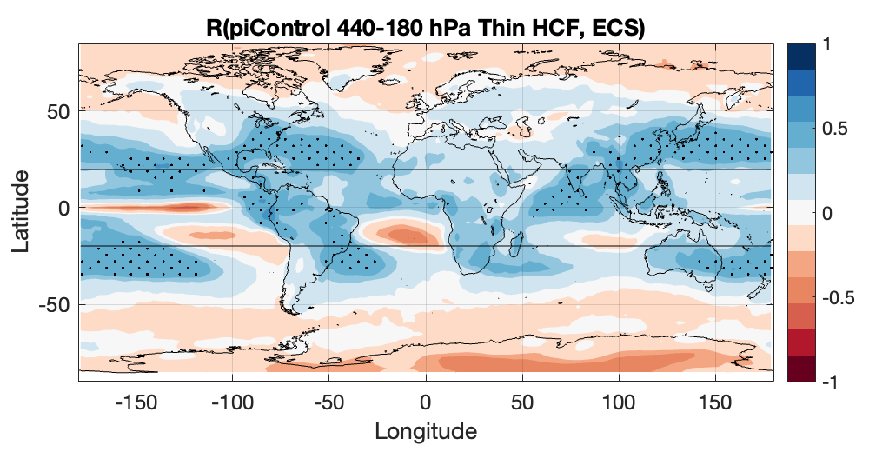
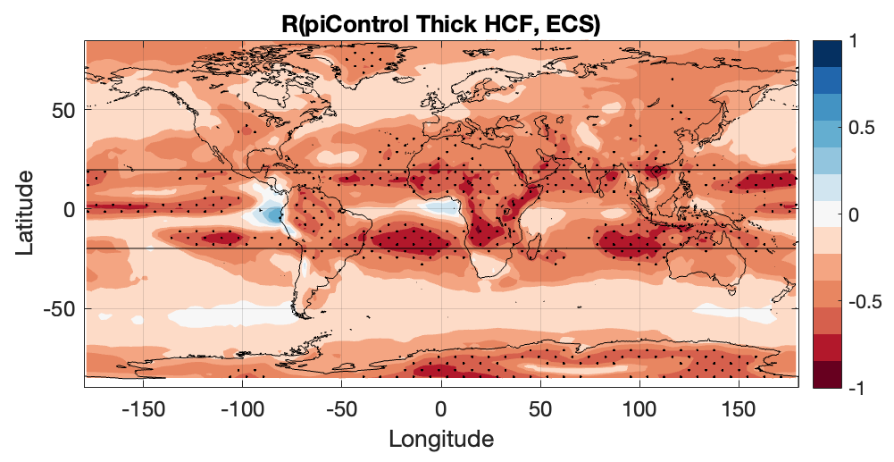
IV. Results - Mean State
High ECS models have:
Fewer thick high clouds on DC margins
More thin high clouds in DC regions

Slide 11
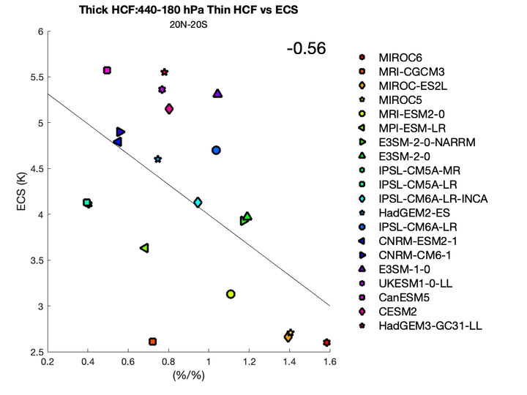
IV. Results - Mean State
Summary: High ECS models have comparatively more thin than thick HCF
Does this relate to the intermodel spread in high cloud feedbacks?

Slide 12
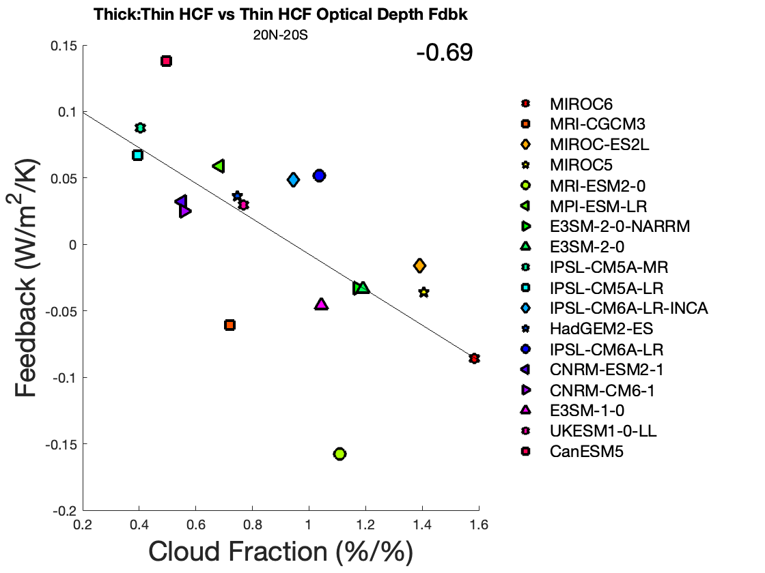
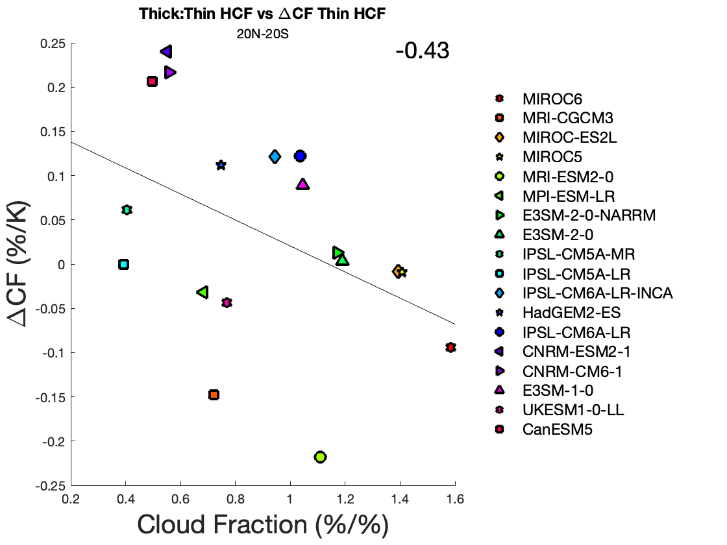
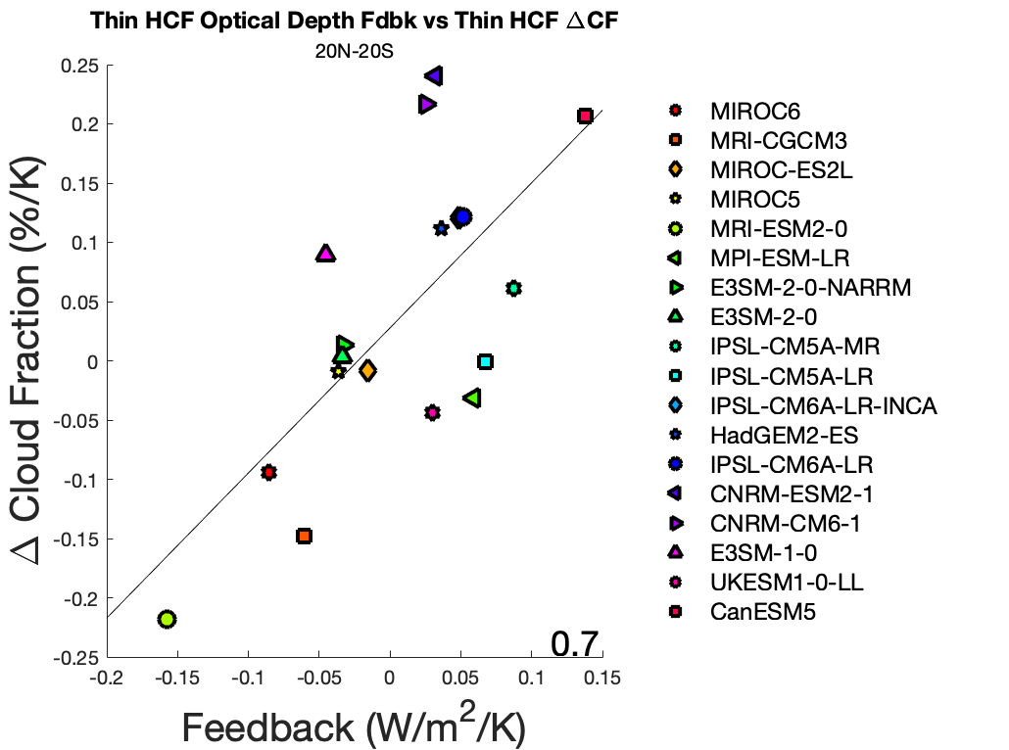
IV. Results - Optical Depth Feedback
Mean-state ratio of thick to thin HCF relates to optical depth feedback
Thinner models show greater anvil thinning

Slide 13
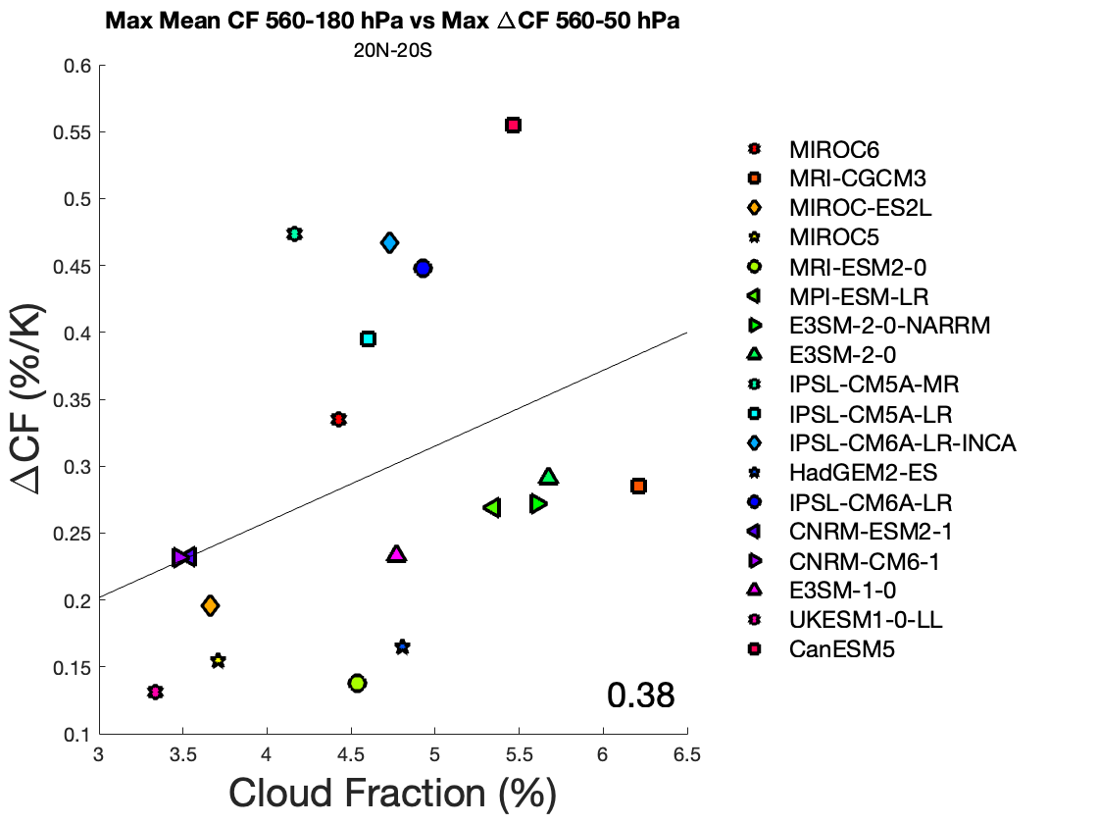
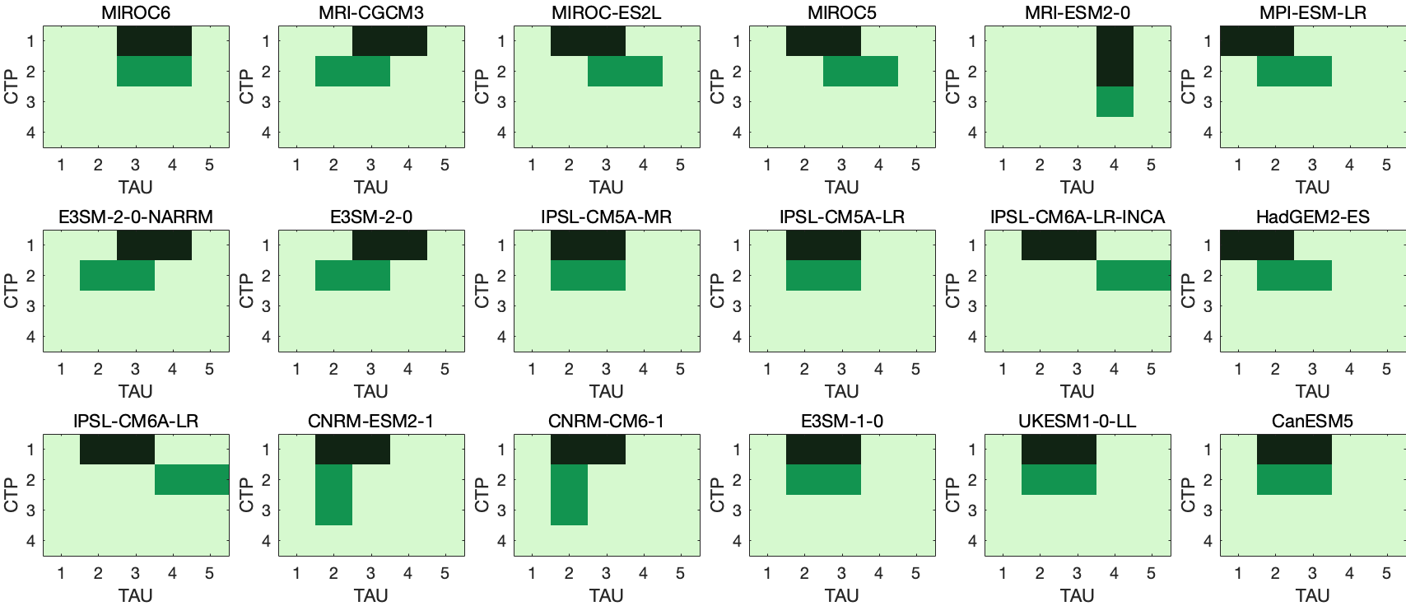
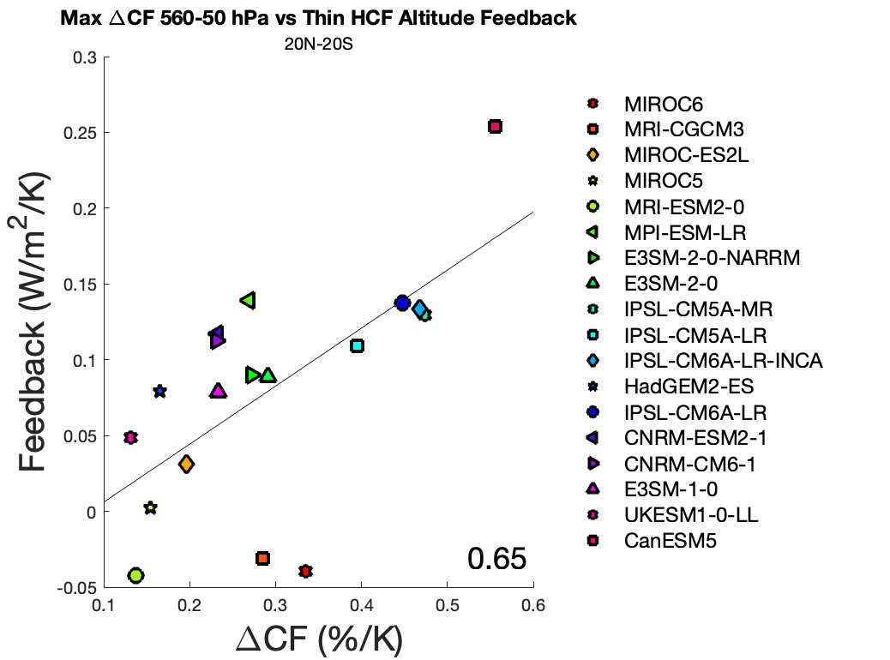
IV. Results - Altitude Feedback
Mean-state HCF (wherever maximum is in 𝛕, CTP space) is related to altitude ΔCF and thin HCF altitude feedback
Especially true for models where cloud altitude changes occur at low 𝛕

Slide 14
VI. Preliminary Conclusions
Thin high cloud optical depth and altitude feedbacks are strongly correlated to ECS
What drives spread?
Mean state relationships?
High ECS models have fewer mean-state thick high clouds and more thin high clouds, comparatively
Thinner mean-state high clouds linked to more positive optical depth feedback
Greater mean-state high clouds (not strictly at low 𝛕) linked to more positive altitude feedback

Slide 15
Thank you!
emd6wn@virginia.edu

Slide 16
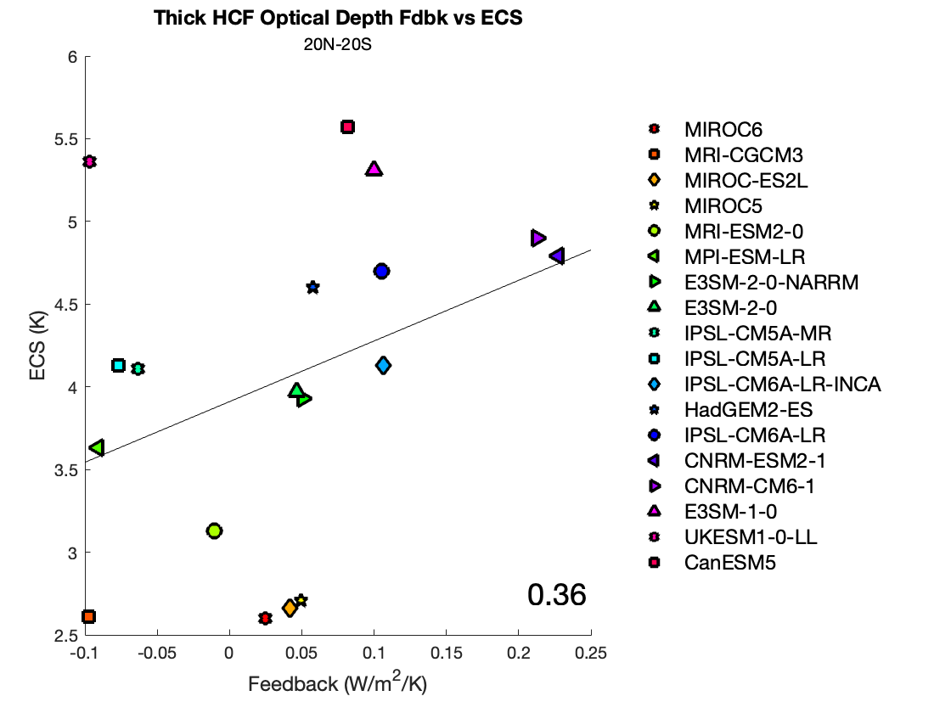
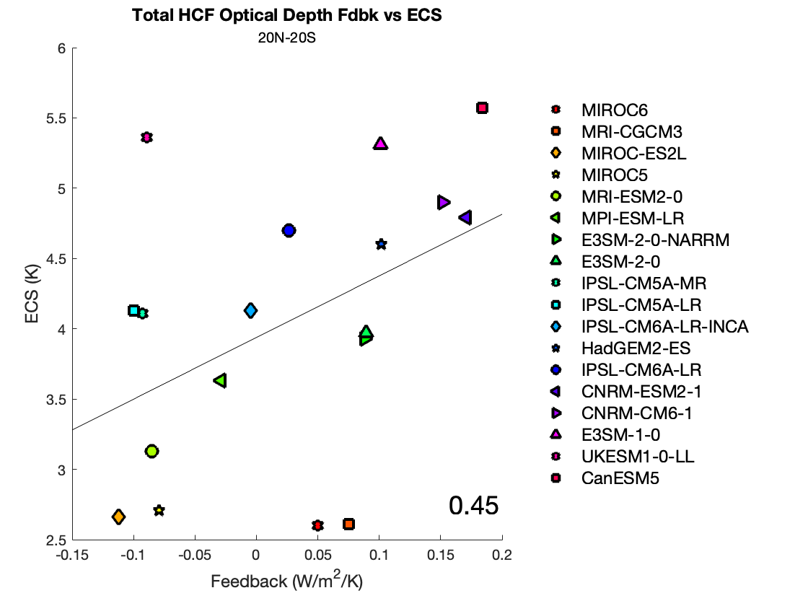
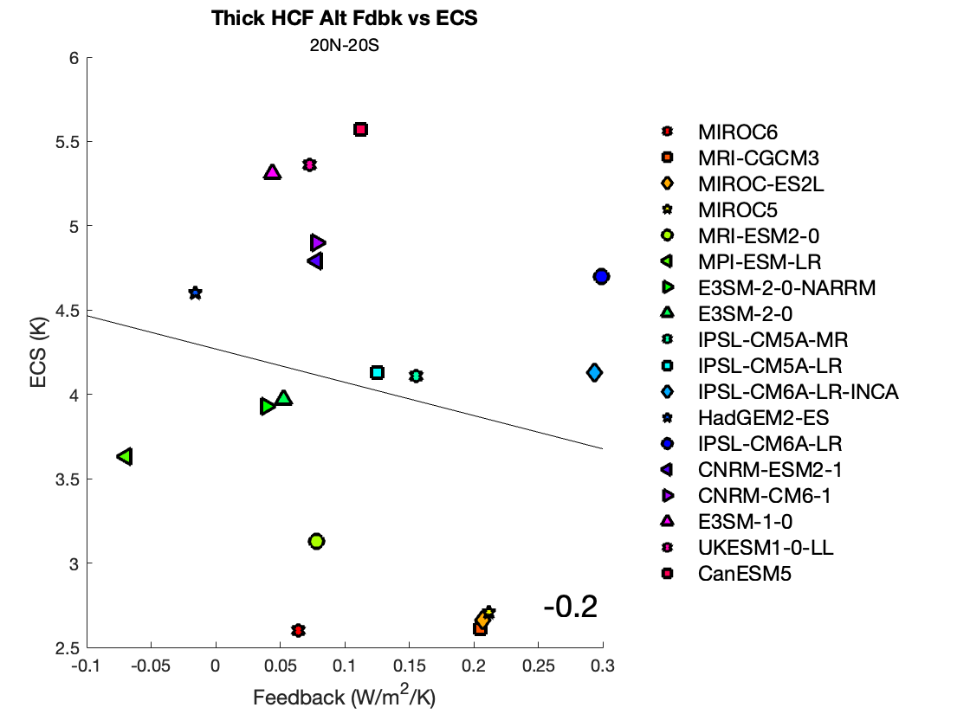
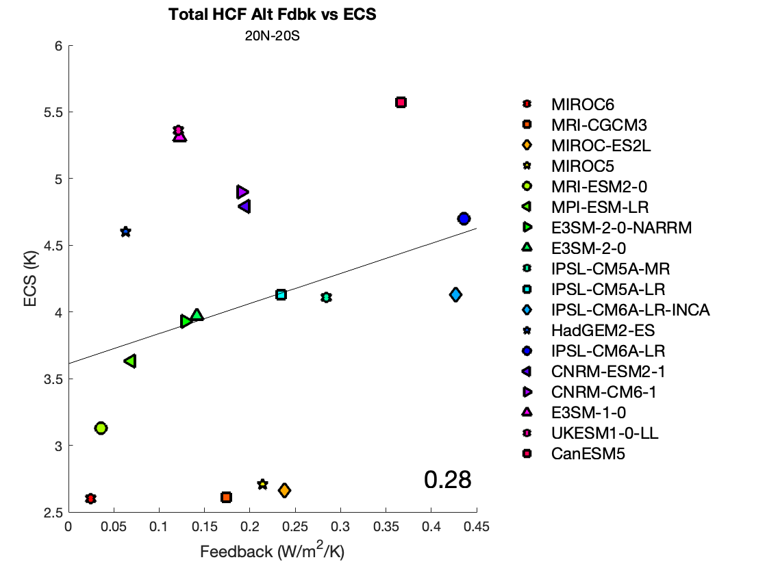
IV. Supplementary Figures - Feedbacks

Slide 17
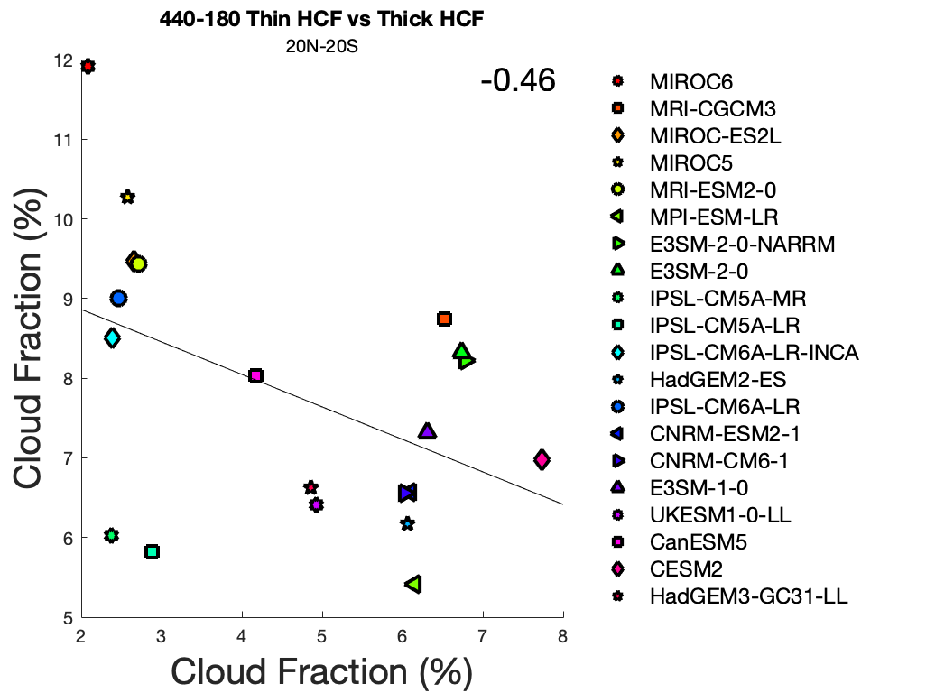
VI. Supplementary Figures - Mean State

Slide 18
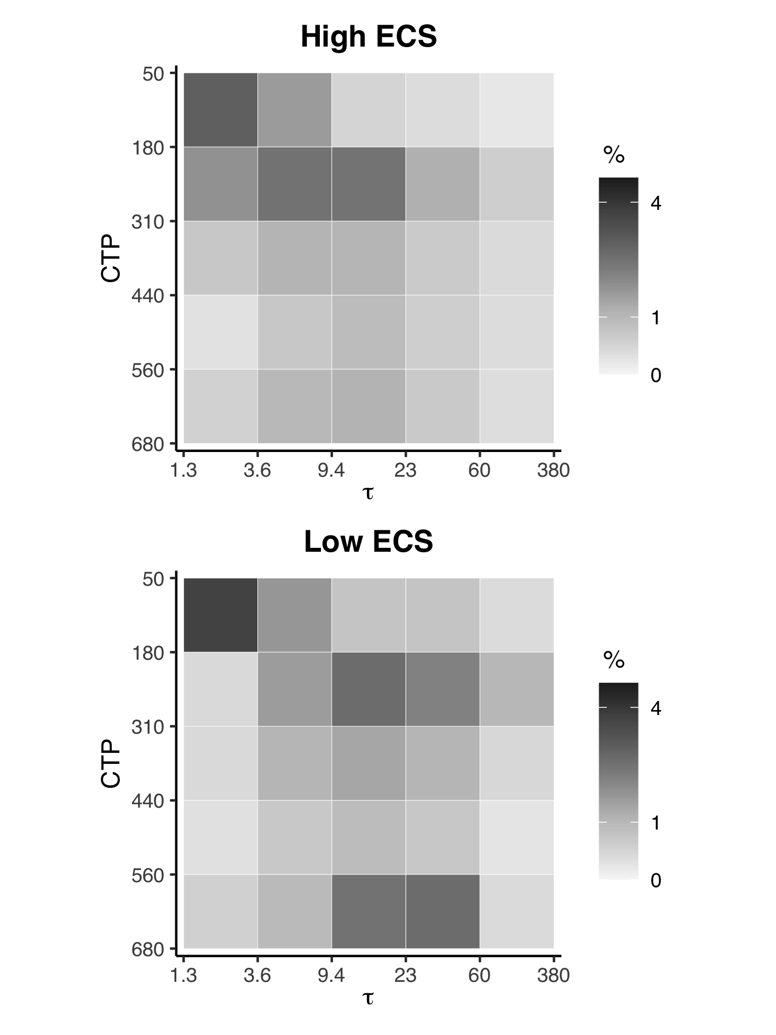
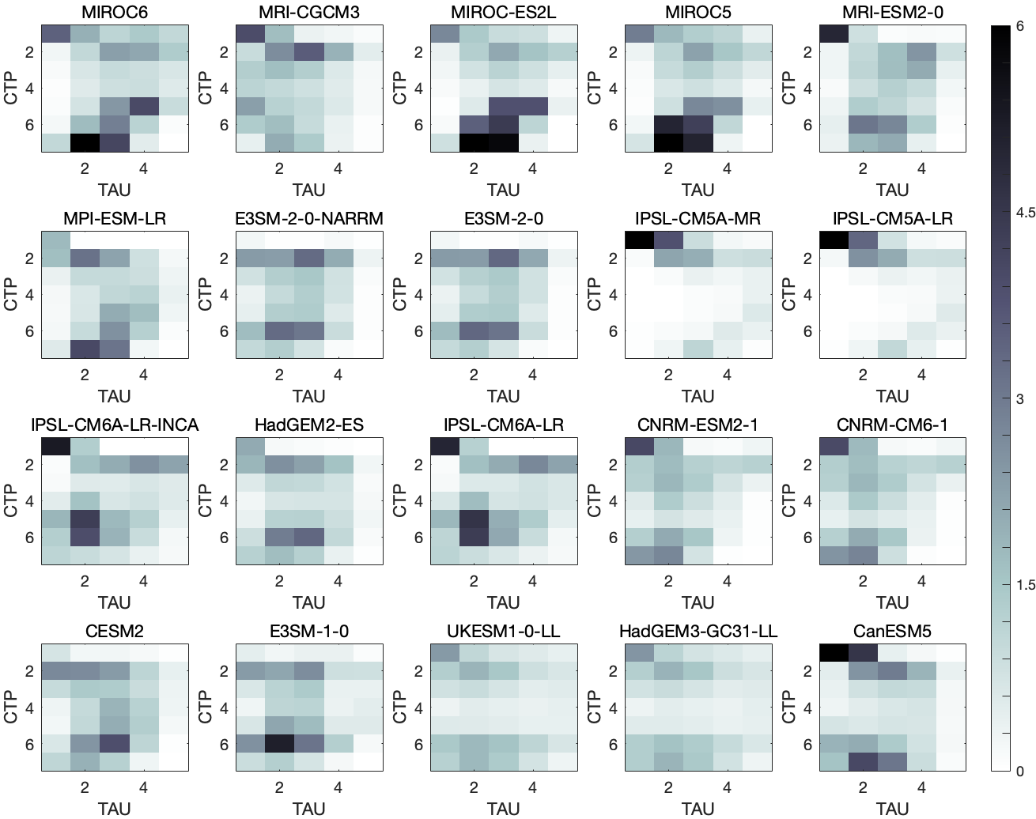
VI. Supplementary Figures - Mean State

Slide 19
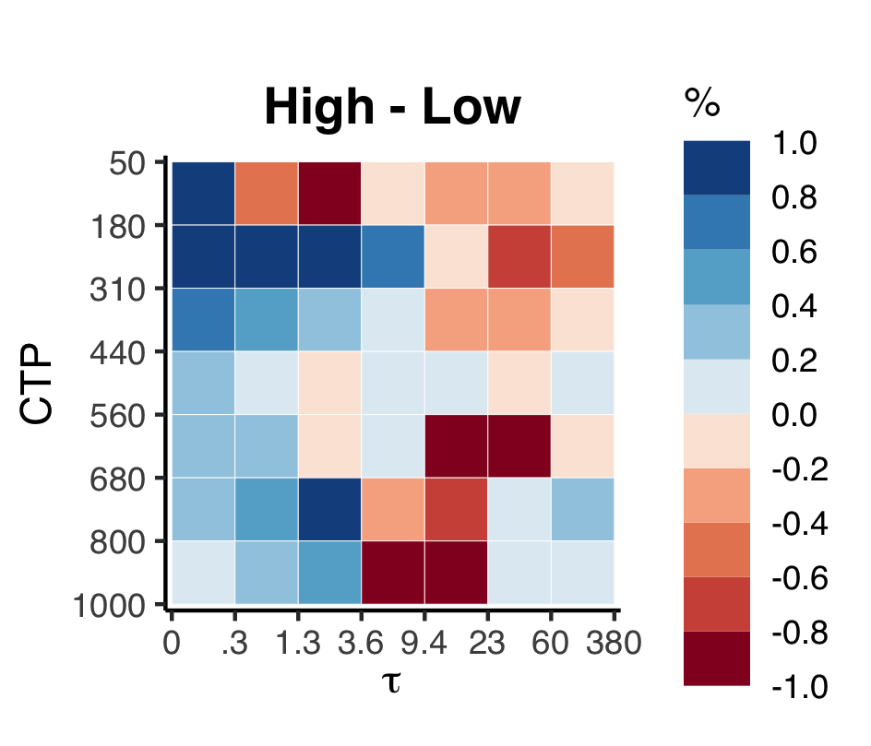
VI. Supplementary Figures - Mean State

Slide 20
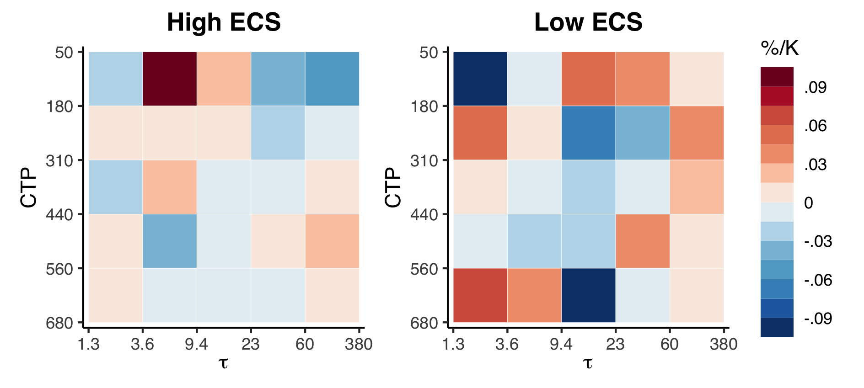
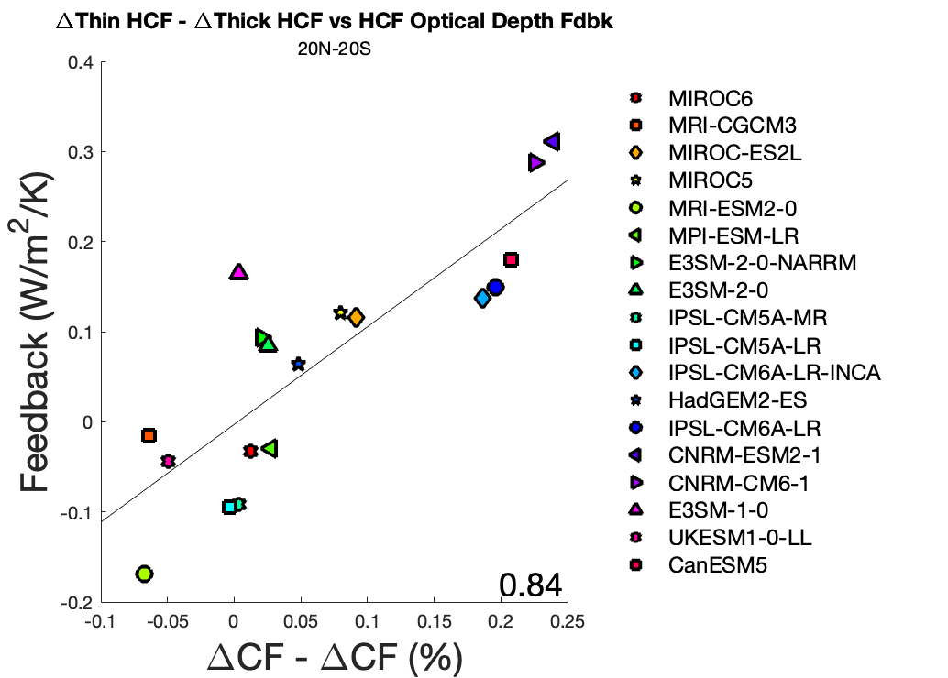
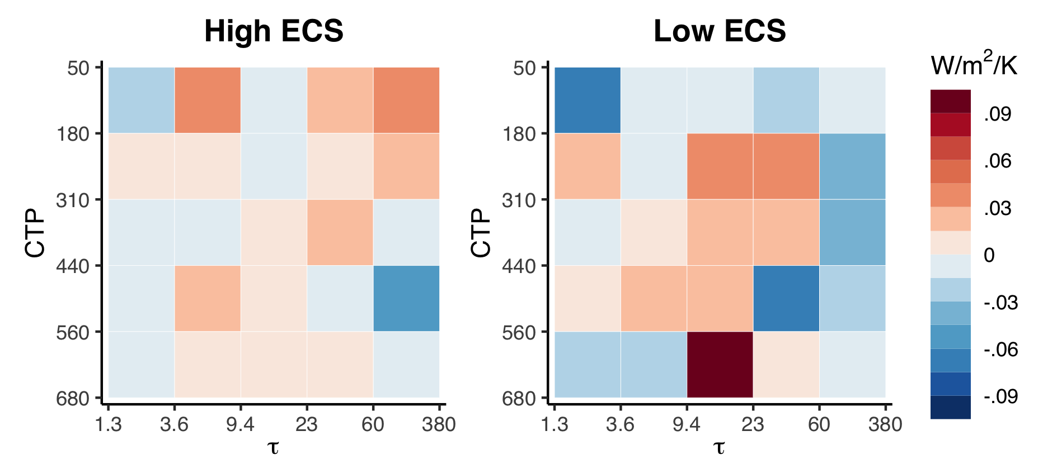
VI. Supplementary Figures - Optical Depth Feedback

Slide 21
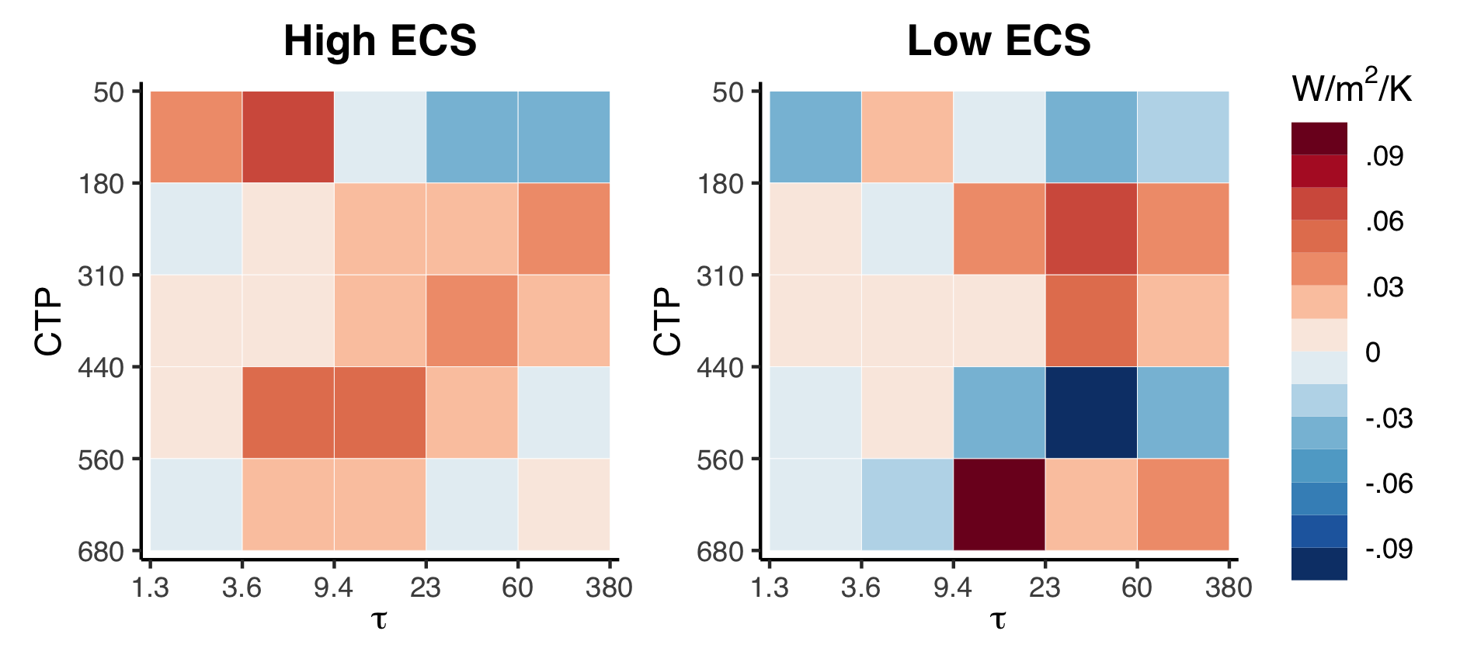
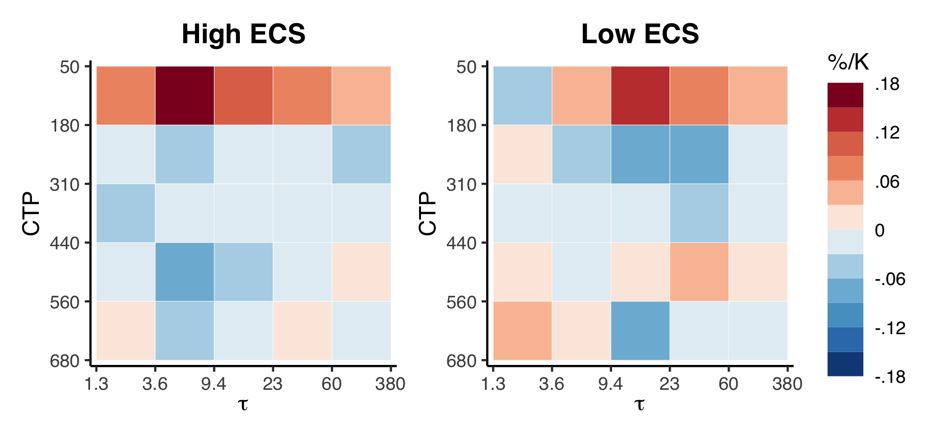
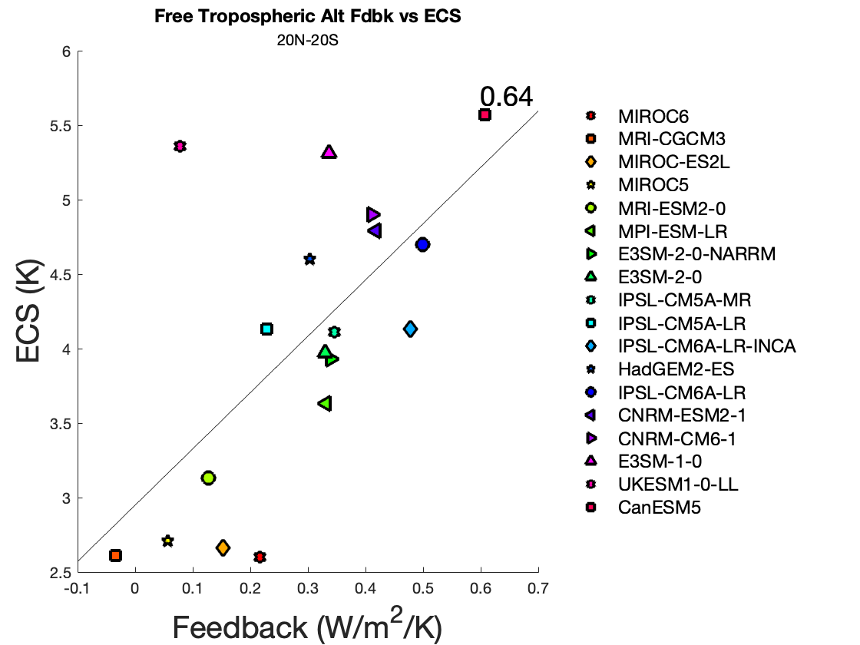
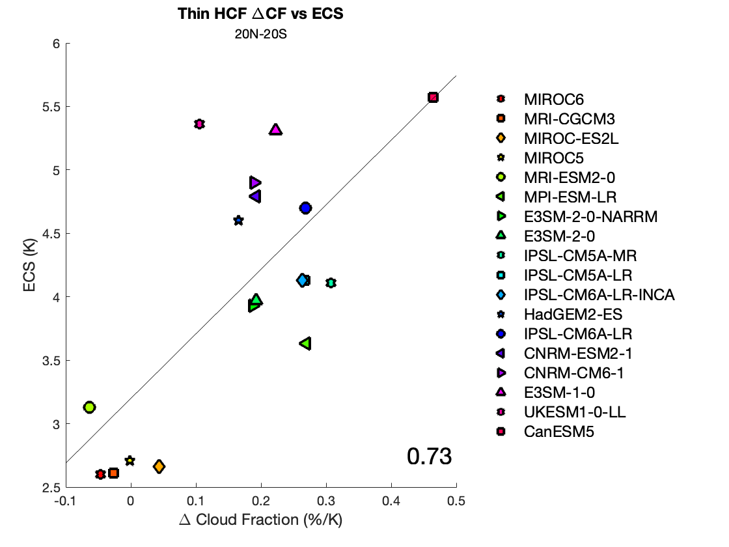
VI. Supplementary Figures - Altitude Feedback

Slide 22
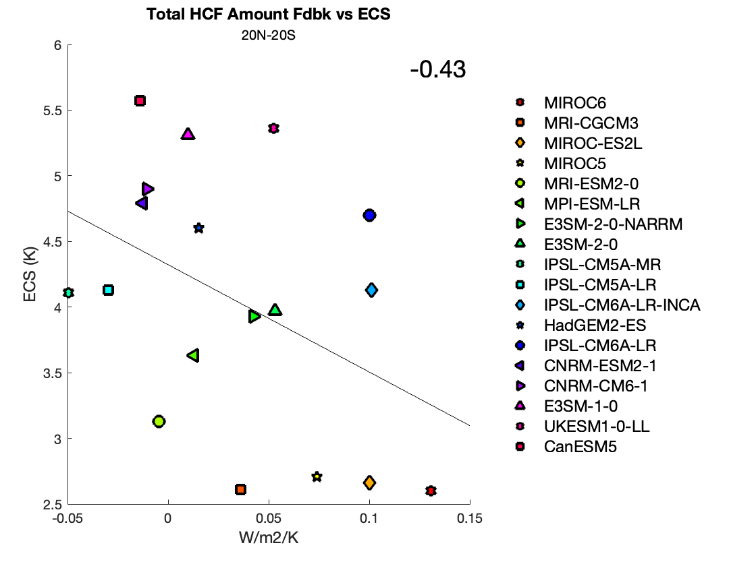
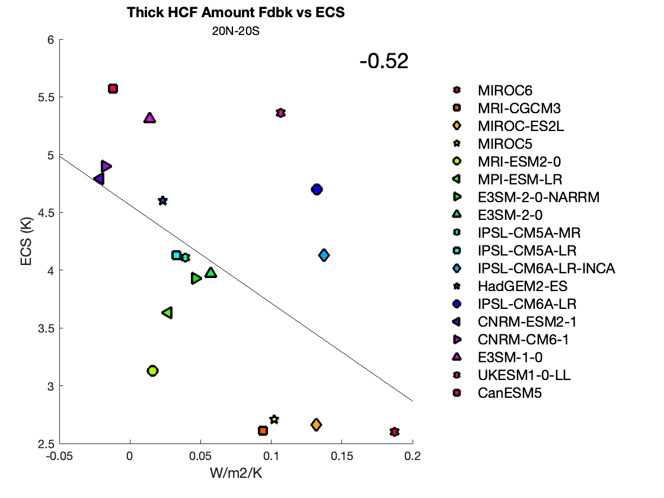
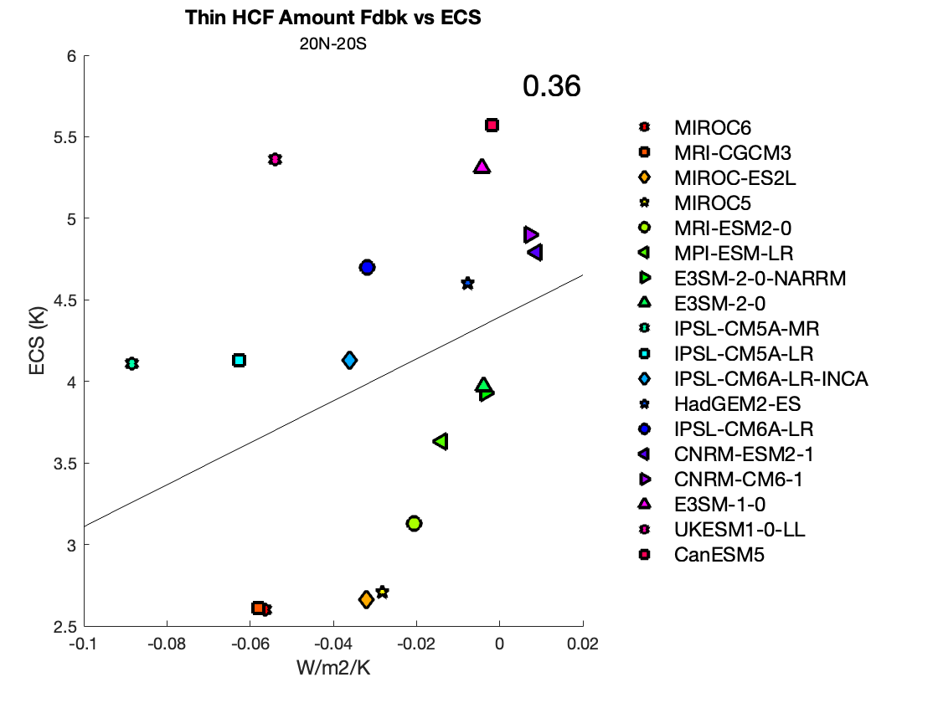
VI. Supplementary Figures - Amount Feedback

Slide 23
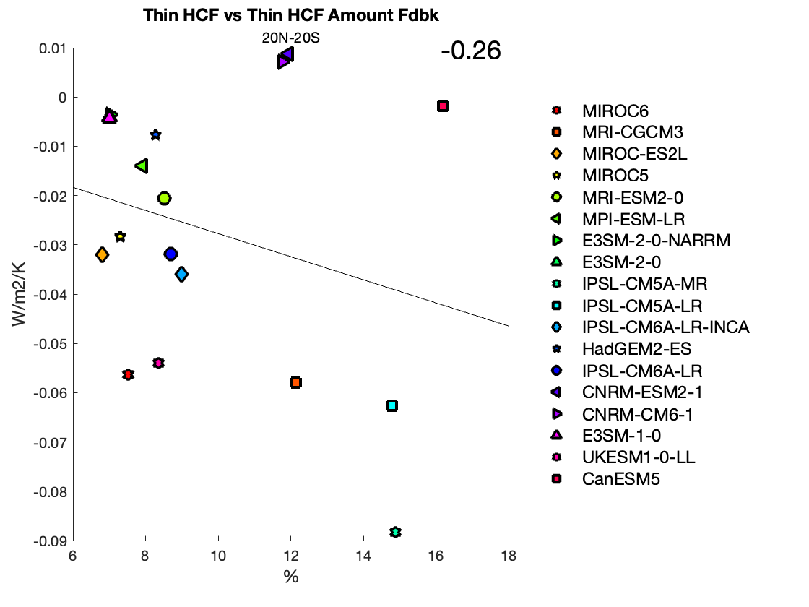
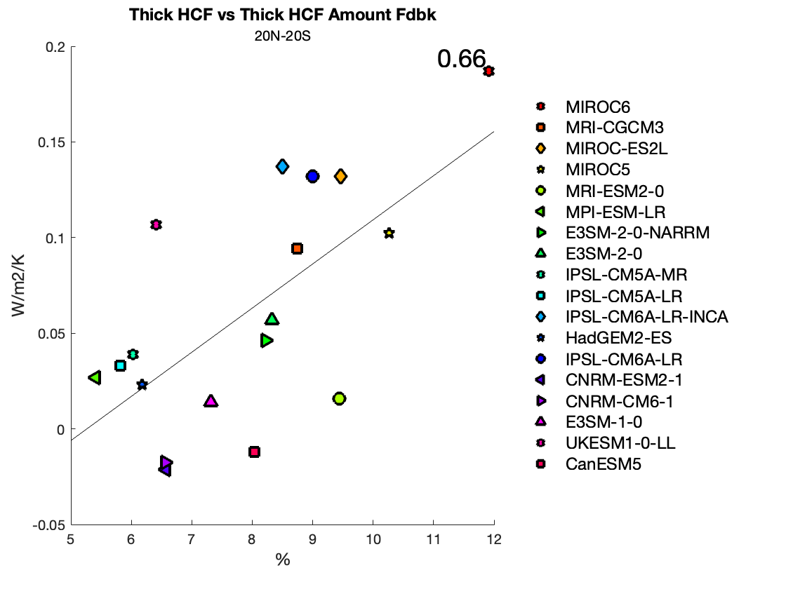
VI. Supplementary Figures - Amount Feedback

