Slide 1
Investigating Environmental Controls on Tropical Mesoscale Convective System Lifecycles Sayali R. Kulkarni¹, Kathleen A. Schiro¹, Gregory Elsaesser² University of Virginia¹, NASA Goddard Institute of Space Studies/Columbia University² 17th April 2023

Slide 2
Scientific Motivation
Tropical mesoscale convective systems (MCS) contribute ~ 75% of annual rainfall across tropics (Maranan et al. 2018)
An attempt to better understand dominant tropical rain-producing systems and MCS-associated processes
Bulk estimates like total column water vapor (TCWV) and buoyancy explored to quantify conditional instability and their relationships to MCS lifecycle
Examine relationship between cold pool characteristics and MCS lifecycle stage
What are the thermodynamic controls on tropical MCS lifecycle (growth, maturity, and decay) and lifetime?
2. How do oceanic cold pools (strength and size) modify the MCS lifecycle?

Slide 3
Data
1. PS tracking dataset: Tracked IMERG Mesoscale Precipitation System (TIMPS; Russell et al. 2022)
0.1° spatial and 30-min temporal resolution; from 2011-2020
PS identified as >3000 km² area and > 10 mm hr⁻¹ maximum precipitation, and allotted an ID
Based on volumetric rain rate and area, PS segregated into growth, mature, and decay stages
2. Thermodynamic variables from ERA5 reanalysis
3. Scatterometer wind-derived cold pool dataset, employed using ASCAT and RapidScat surface wind-vector retrievals provide us with gradient features (GF; Garg et al. 2020).
Mature
Volumetric Rain Rate averaged over a 3° x 3 ° grid for 2014-2016

Slide 4
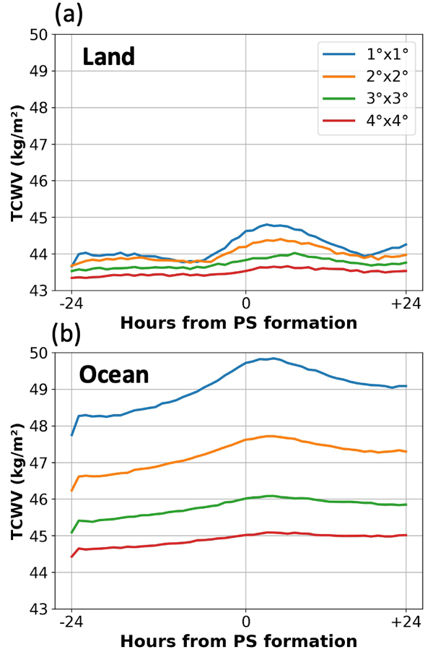
What are the thermodynamic controls on tropical MCS lifecycle (growth, maturity, and decay) and lifetime?
Composite time-series of ERA5 TCWV across storm-centric TIMPS PSs averaged over 1°, 2°, 3°, and 4° grid-box for 2015 (~160,000 systems)
TCWV upsurge noticed ~ 6 hours prior to MCS genesis over both land and ocean
Gradual increase in TCWV seen within the 24-hour period before MCS genesis over ocean; no signal detected before 6-8 hours prior over land
Beyond 2º x 2º, signal is significantly reduced

Slide 5
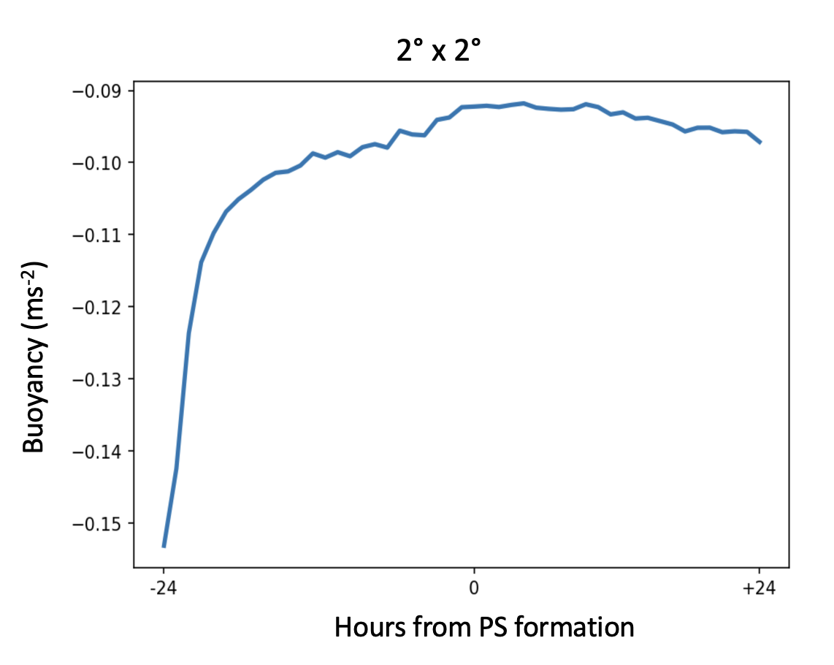
What are the thermodynamic controls on tropical MCS lifecycle (growth, maturity, and decay) and lifetime?
Entraining Plume Buoyancy Model
1000-850 hPa MSE
850-500 hPa MSE
Saturation deficit = Saturation SH - SH
Exner fx for BL (925 hPa) and LFT (625 hPa)
Undiluted buoyancy: MSE difference b/w 1000-850 hPa (saturated)
Diluted buoyancy: 850-500 hPa saturation deficit
Buoyancy = Undiluted + Diluted
Helps us quantify how rapid onset of precipitation is linked to lower tropospheric buoyancy
Assumes inflow in an MCS occurs through a deep 4-5 km layer of lower troposphere (Schiro et al. 2018; Kingsmill and Houze 1999)
Lower troposphere and BL have equal effects on buoyancy available for deep convection
A bulk quantity with less vertical resolution, showing potential to better explain precipitation intensity

Slide 6
What are the thermodynamic controls on tropical MCS lifecycle (growth, maturity, and decay) and lifetime?
How does the thermodynamic environment affect MCS propagation direction and organization?

Slide 7
How does the thermodynamic environment affect MCS propagation direction and organization?
N
177°
TCWV around the storm extracted, rotated, and composited such that system’s direction of motion is at 0° (true North)
x°
x °
x°
System motion away from high TCWV (growth), and towards high TCWV (decay).
Possible that a decaying system preferentially travels towards high TCWV to save itself from other disfavorable environmental conditions
Rotational composite analysis of TCWV anomaly across 2° x 2°

Slide 8
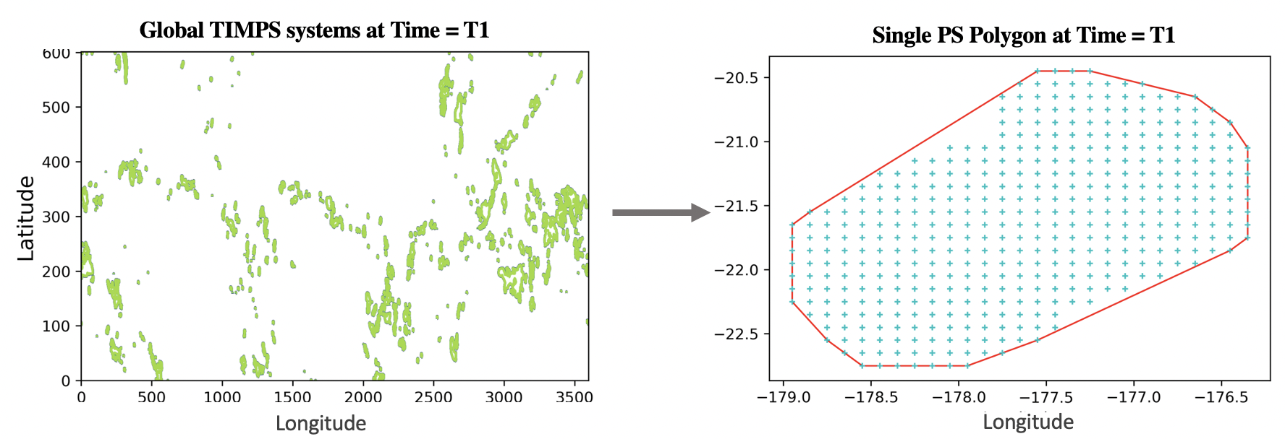
PS polygons created using convex hull technique to identify system overlap with new high-resolution NASA AIRS single footprint retrievals of temperature and moisture profiles (Irion et al. 2018)
30
Latitude
0
-30
-180
180

Slide 9
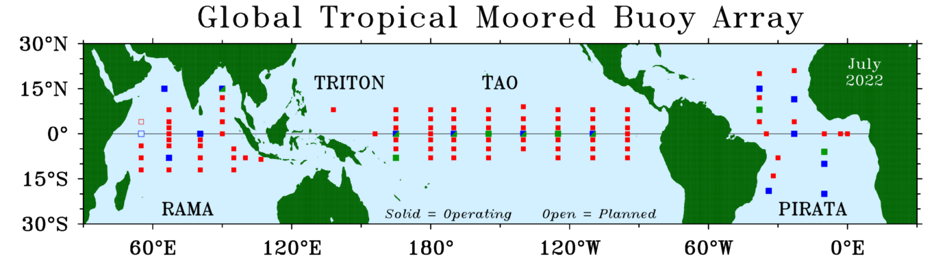
2. How do oceanic cold pools modify MCS lifecycle?
Cold pools play an imperative role in dictating the intensity and lifecycle of an MCS (Elsaesser et al. 2013, Schiro et al. 2020, Zuidema et al. 2017)
Buoys capture thermodynamic evolution of environment following the passage of cold pools and MCSs
Environmental air T decreases from growth to mature to decay phases, while ~0.5ºC decrease in T across stages.
Decrease in T detected ahead of MCS for mature and decay phases – indicative of cold pool expansion
Temporal analysis from 2014-16 of air temperature for a TRITON buoy (circled yellow) for +/- 5 hours. 0th hour is the closest time when PS passes the buoy.
Air Temperature (°C)
Hours from PS time closest to buoy

Slide 10
2. How do oceanic cold pools modify MCS lifecycle?
Cold Pool Identification
Envelopes of convective mesoscale downdrafts, i.e., cold pools, are regions of cooler-than-ambient air
Sharp surface-wind gradients along the gust front used to identify “gradient features” (Garg et al. 2020, 2021)
GF algorithm employs EUMETSAT’s Advanced Scatterometer (ASCAT; 2007-2018) and NASA’s RapidScat (2014-2016) surface wind-vector retrievals (12.5 km spatial resolution) to detect cold pools over tropical oceans
GF dataset offers variables like size, thermal fluxes, precipitation, TCWV, and brightness temperature associated with every GF system

Slide 11
Do thermodynamic and size thresholds exist whereby cold pools limit future growth of convection?
Collocated Dataset
Involve more buoys in the picture!
A topological collocation by adding 2º buffer each to GF and PS polygons
Helps us segregate GFs associated with growth, mature, and decay PSs
Includes cold pool(s) moved away from the parent PS
A new data product!

Slide 12
Do thermodynamic and size thresholds exist whereby cold pools limit future growth of convection?
Case study illustrates a strengthening MCS seemingly uninhibited by its own cold pool(s) b/w 0630 and 1300 UTC.
Environment recovers quickly with passage of weaker (t=02-10-08) and stronger (t=02-10-14) cold pools

Slide 13
Summary
Science Question 1
Quantify bulk thermodynamic quantities like TCWV and buoyancy using an entraining plume buoyancy model to understand MCS precipitation onset for growth, mature, and decay stages
Science Question 2
Create a novel multi-platform database involving collocated PS + GF datasets + buoy + thermodynamic quantities (ERA5, AIRS) to gain insight into cold-pool-MCS interactions
Science Question 1 + Science Question 2
Evaluate regional variability to explain unique local dynamic and thermodynamic forcings

Slide 14
Contact Information
Sayali R. Kulkarni
ejb6nj@virginia.edu
University of Virginia
Kathleen Schiro
kschiro@virginia.edu
University of Virginia
Gregory Elsaesser
gregory.elsaesser@columbia.edu
NASA GISS/Columbia University

Slide 15
Supplementary
Area (km²)
~ 7° x 7°
~ 8° x 8°
~ 7° x 7°
Area (km²) categories:
Small (S): 4000 to 10,000;
Medium (M): 10,000 to 30,000
Large (L): 30,000 to 50,000
Extra Large (XL): >50,000
Unicentric Composite of TCWV anomaly for 2015

